Slide 1
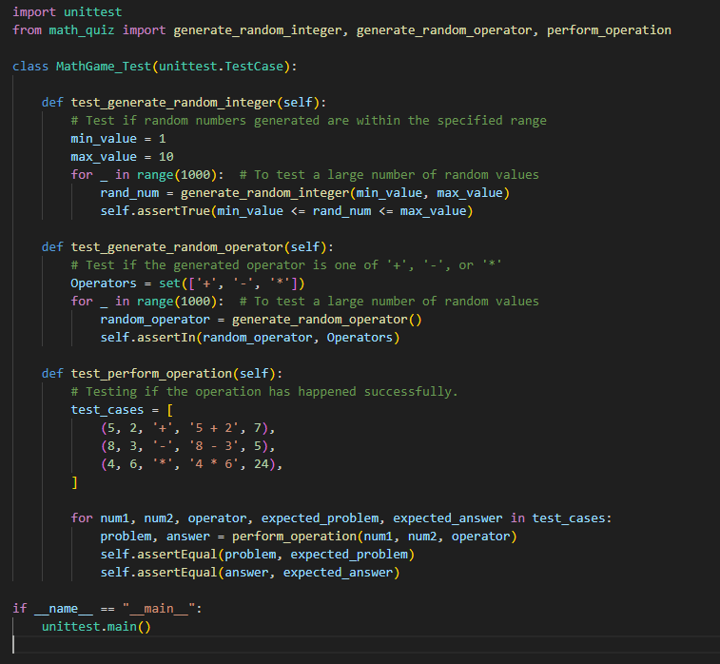

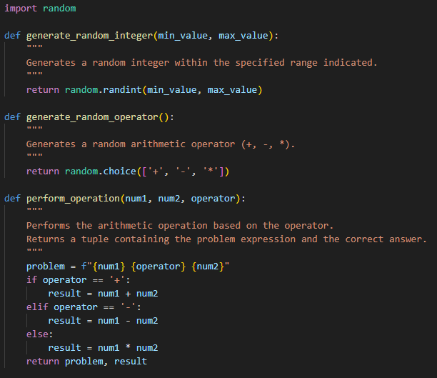
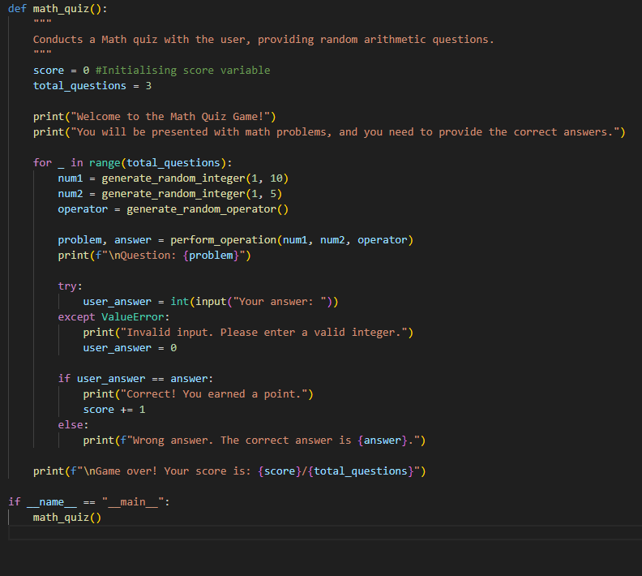
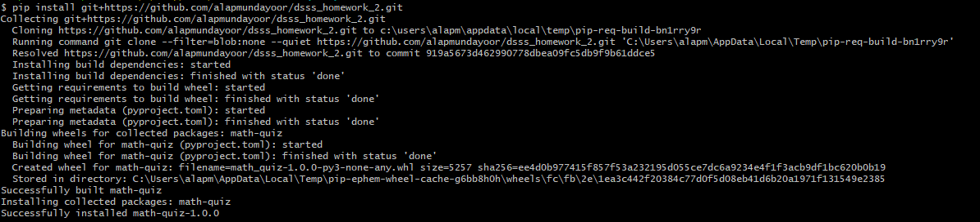
https://github.com/alapmundayoor/dsss_homework_2
Task 4
Task 3
Task 5:
Alap Mundayoor, M.N. 23351429, IdM: ow07ysym

